Slide 1
SWE3002: Information & Systems Security
Module 2 Elementary Cryptography
Prof. Jayasudha M, VIT Chennai

Slide 2
Classical encryption techniques
As opposed to modern cryptography
Goals:
to introduce basic concepts & terminology of encryption
to prepare us for studying modern cryptography

Slide 3
Ciphers
Symmetric Algorithms
Encryption and Decryption use the same key
i.e. KE = KD
Examples:
Block Ciphers : DES, AES, PRESENT, etc.
Stream Ciphers : A5, Grain, etc.
Asymmetric Algorithms
Encryption and Decryption keys are different
KE ≠ KD
Examples: RSA,ECC

Slide 4
Basic terminology
Plaintext: original message to be encrypted
Ciphertext: the encrypted message
Enciphering or encryption: the process of converting plaintext into ciphertext
Encryption algorithm: performs encryption
Two inputs: a plaintext and a secret key
Deciphering or decryption: recovering plaintext from ciphertext
Decryption algorithm: performs decryption
Two inputs: ciphertext and secret key

Slide 5
Secret key: same key used for encryption and decryption
Also referred to as a symmetric key
Cipher or cryptographic system : a scheme for encryption and decryption
Cryptography: science of studying ciphers
Cryptanalysis: science of studying attacks against cryptographic systems
Cryptology: cryptography + cryptanalysis

Slide 6
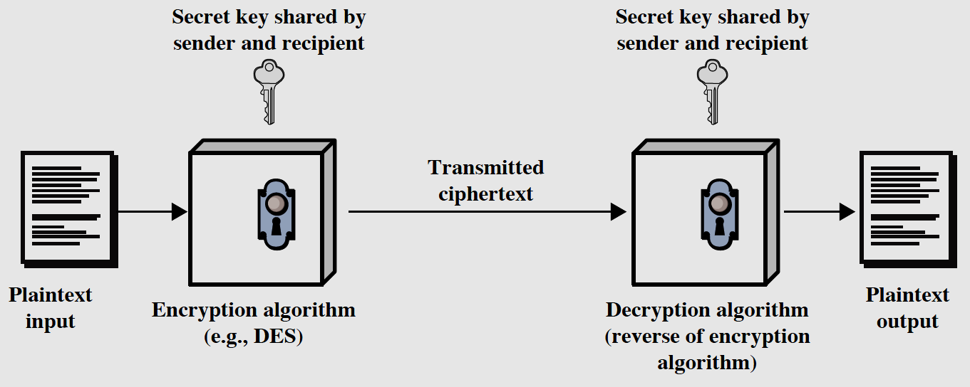
Symmetric Cipher Model

Slide 7
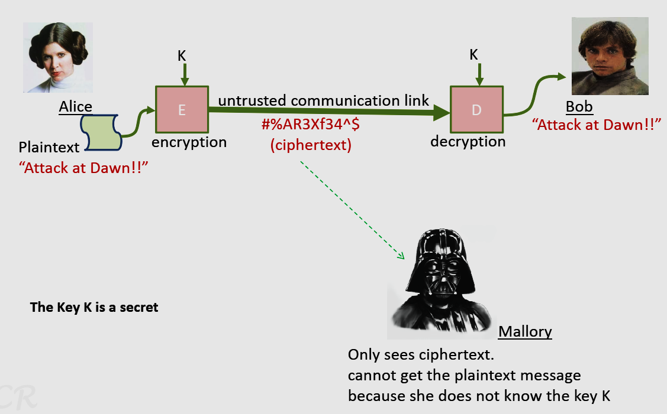
Encryption(Symmetric cipher)

Slide 8
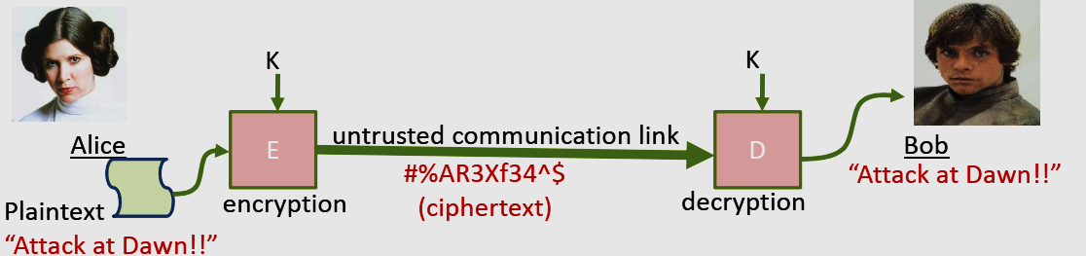
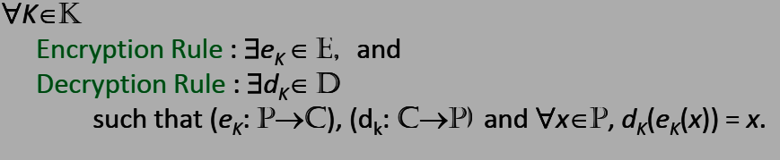
A Crypto system
A cryptosystem is a five-tuple (P,C,K,E,D), where the following are satisfied:
P is a finite set of possible plaintexts
C is a finite set of possible ciphertexts
K-keyspace, is a finite set of possible keys
E is a finite set of encryption functions
D is a finite set of decryption functions

Slide 9
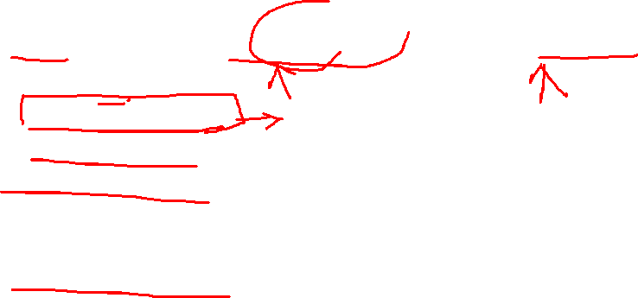
Cryptanalysis
Mallory wants to some how get information about the secret key.
Attack models:
ciphertext only attack
known plaintext attack
chosen plaintext attack
Mallory has temporary access to the encryption machine. He can choose the plaintext and get the ciphertext.
chosen ciphertext attack
Mallory has temporary access to the decryption machine. He can choose the ciphertext and get the plaintext
Given: (m₁,c₁), (m₂,c₂), …, (m_{k},c_{k}) and a new ciphertext c

Slide 10
Classical Ciphers
Plaintext is viewed as a sequence of elements (e.g., bits or characters)
Substitution cipher: replacing each element of the plaintext with another element.
Transposition (or permutation) cipher: rearranging the order of the elements of the plaintext.
Product cipher: using multiple stages of substitutions and transpositions

Slide 11
Substitution Cipher-Caesar Cipher
earliest known substitution cipher
by Julius Caesar
first attested use in military affairs
each letter in the alphabet is rotated by three letters as shown
A B C D E F G H I J K L M N O P Q R S T U V W X Y Z
D E F G H I J K L M N O P Q R S T U V W X Y Z A B C

Slide 12
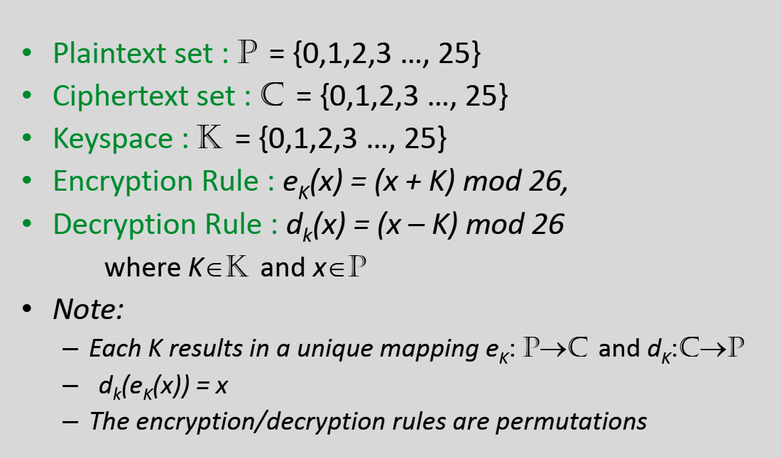

Slide 13
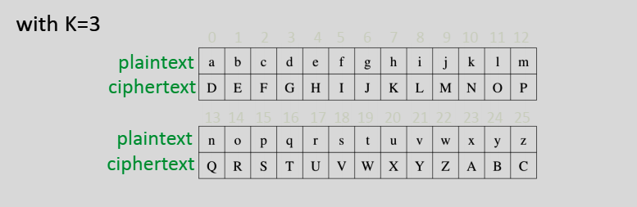
Using the Caesar Cipher
attackatdawn DWWDFNDWFDZQ

Slide 14
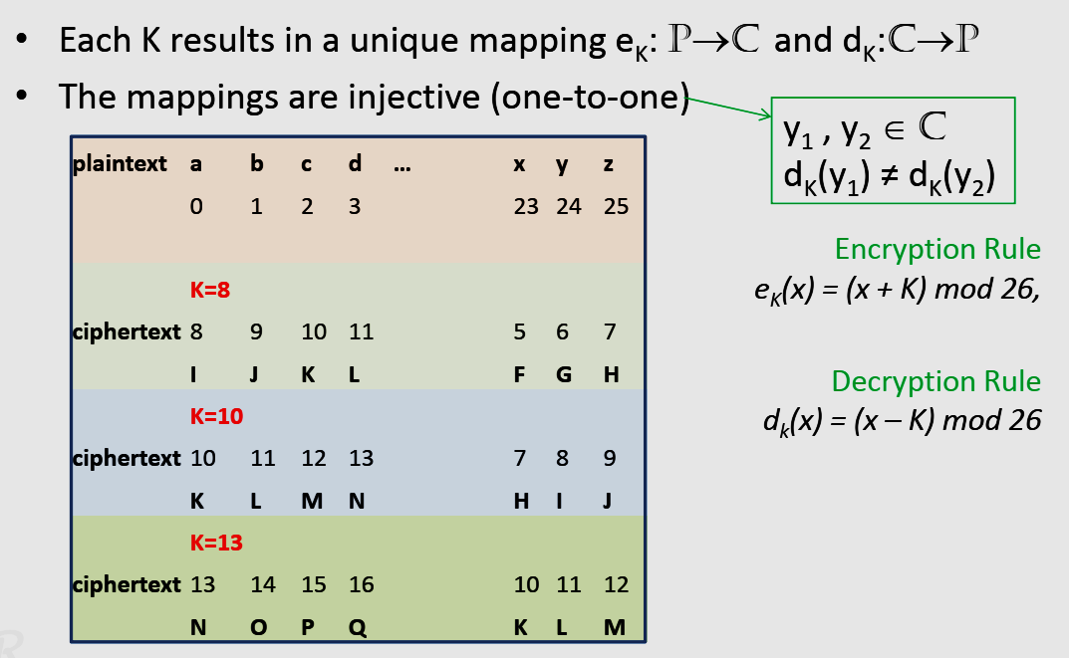
Caesar Cipher Mappings

Slide 15
How good is the Caesar Cipher
A good cipher has two properties – Easy to compute • Satisfied – An attacker (Mallory), who views the ciphertext should not get any information about the plaintext. • Not Satisfied!! • The attacker needs at-most 26 guesses to determine the secret key …. – This is an exhaustive key search (known as brute force attack)

Slide 16
Cryptanalysis of Shift Cipher
By Brute Force….
Cipher Text: DWWDFNDWGDZQ
26 possible keys
Try all of them:
Key=0, “dwwdfndwgdzq”
Key=1, “cvvcemcvfcyp”
Key=2, ”buubdlbuebxo”
Key=3, “attackatdawn” … makes sense

Slide 17
Puzzle
Cryptanalyze, assuming a caesar cipher
“COMEBSDISCKCCDBYXQKCSDCGOKUOCDVSXU”

Slide 18
Monoalphabetic Substitution Cipher
Shuffle the letters and map each plaintext letter to a different random ciphertext letter
we have a total of 26! = 4 x 10²⁶ keys.
With so many keys, it is secure against brute-force attacks.
But not secure against some cryptanalytic attacks.
Problem is language characteristics.

Slide 19
Monoalphabetic Cipher
Plain text set : P = {a,b,c,d,…,z}
Ciphertext set : C = {A,B,C,D,…,Z}
Keyspace : K = {π | such that π is a permutation of the alphabets}
Size of keyspace is 26!
Encryption Rule : eπ(x) = π(x),
Decryption Rule : dπ (x) = π⁻¹(x)

Slide 20
Example
Plain Text
A | B | C | D | E | F | G | H | I | J | K | L | M
Z | J | H | K | F | G | I | D | B | E | A | C | P
N | O | P | Q | R | S | T | U | V | W | X | Y | Z
Y | M | S | L | V | N | X | O | T | R | Q | U | W
Plain Text: ATTACKATDAWN
Cipher Text:ZXXZAZXKZRY

Slide 21
Cryptanalysis of monoalphabetic
Languages do not have uniform probabilities
calculate letter frequencies for ciphertext
compare counts/plots against known values
if Caesar cipher look for common peaks/troughs
peaks at: A-E-I triple, NO pair, RST triple
troughs at: JK, X-Z
for Monoalphabetic must identify each letter
tables of common double/triple letters help

Slide 23
Example Cryptanalysis
Given ciphertext:
UZQSOVUOHXMOPVGPOZPEVSGZWSZOPFPESXUDBMETSXAIZ
VUEPHZHMDZSHZOWSFPAPPDTSVPQUZWYMXUZUHSX
Count relative letter frequencies
guess {P, Z} = {e, t}
Of double letters, ZW has highest frequency, so guess ZW = th and hence ZWP = the
Proceeding with trial and error finally get:
it was disclosed yesterday that several informal but
direct contacts have been made with political
representatives of the viet cong in moscow

Slide 24
MEET ME AFTER YOGA CLASS IN BULE HIGHWAYS

